Slide 1
No Substitutes Accepted
Reading - 1 Samuel 15:10-23

Slide 2
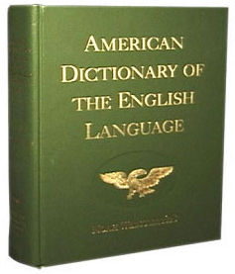
Definition of a Substitute
“to put under, put or use in the place of, or instead of; to take the place of; a person or thing put in the place of another; to replace; take the place of something or someone.

Slide 3
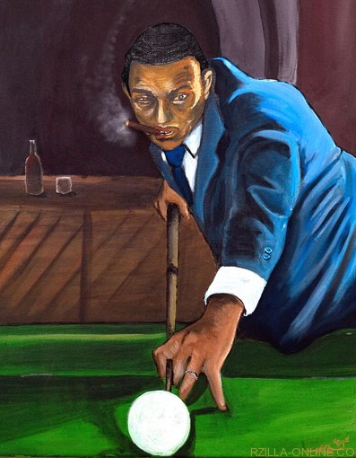
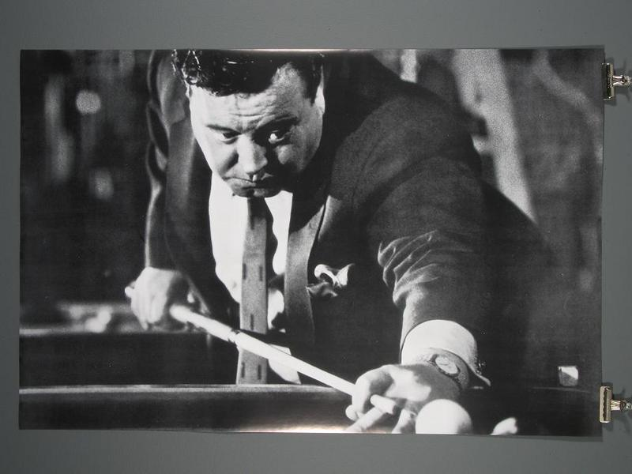
The End Justifies the Means?

Slide 4
The End Justifies the Means?

Slide 5
Biblical Examples of Unsuccessful Substitutes
Cain: (Genesis 4:1-8) (Hebrews 11:4)
Sarai and Abram: Genesis 16:1-16 and 21:1-12
Nadab and Abihu: (Leviticus 10:1-2)
King Saul: 1 Samuel 15:1-23

Slide 6
God will not accept sacrifices or offerings, no matter how abundant or how costly, as a substitute for repentance.
Proverbs 15:8
Malachi 1:6-14

Slide 7
What Does Jesus think about substitutes?
(Matthew 15:7-9)
(John 4:24)

Slide 8
Modern Substitutes
Doctrines
Calvin
Luther
Smith
(2 John 1:9-11)
Wesley
Aquinas
“Does NOT have God”

Slide 9
Modern Substitutes
Names
Methodist
Catholic
Mormon
(Matthew 16:18)
Baptist
Anglican
“I will build MY church”

Slide 10
Modern Substitutes
Matthew 15:13
Salvation
(John 14:6)
Matthew 7:13-14
"I am the way, the truth, and the life.”

Slide 11
Modern Substitutes
Mark 16:15-16
Baptism
Sprinkling
Prayer
Colossians 2:12
Dedication
(Romans 6:3-4)
Infants
Acts 2:38
Pouring
“Buried with Him thru Baptism”

Slide 12
Modern Substitutes
Mark 16:15-16
Music
Rock Bands
Soloists
Colossians 3:16
Orchestras
(Ephesians 5:19)
Choirs
Acts 2:38
Light Shows
“Singing & making melody in your heart”

Slide 13
Modern Substitutes
Religious Titles
Reverend
Most Worshipful Master
Apostle
(Matthew 23:8&9)
Lady Bishop
Pontiff
“You are all brothers. Call no man father”

Slide 14
Modern Substitutes
Mediator
Priest
Mary
Saints
(1 Timothy 2:5)
Pope
“For there is one God and one Mediator between God and men, the Man Christ Jesus”

Slide 15
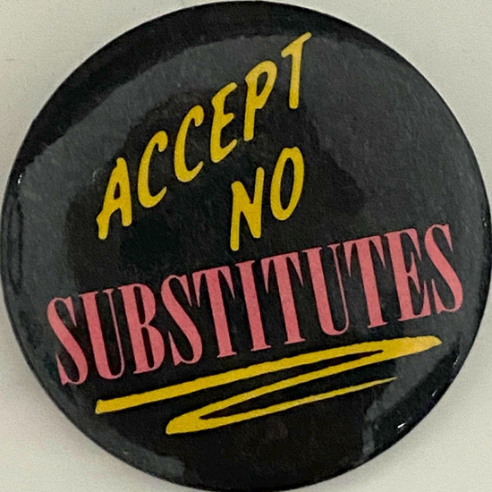
Why Settle For A Substitute When You Can Have The Authentic Thing?

