Slide 1
Putting The Lord’s Prayer into Context
Reading – John 17:13-18:1

Slide 2
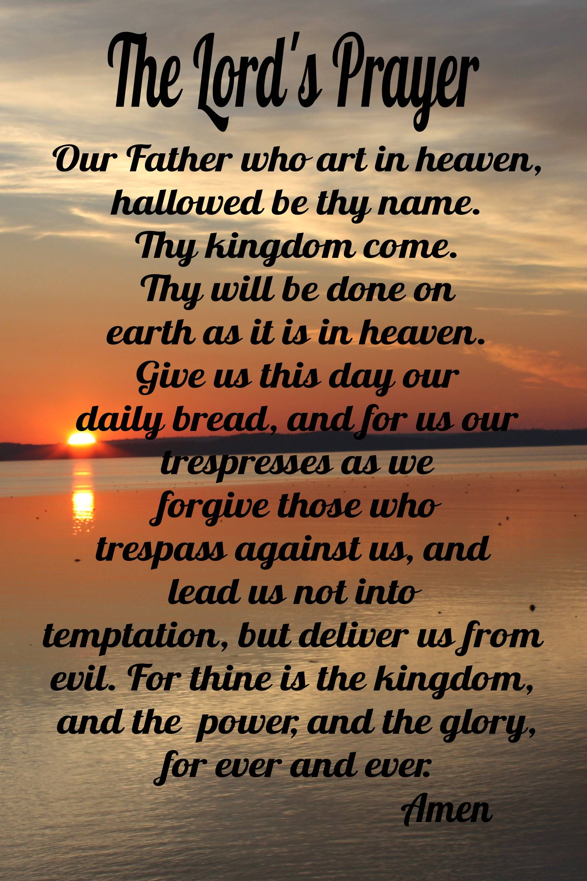
John 17 is the REAL Lord’s Prayer
What the religious world calls the Lord’s Prayer appears in two forms in the New Testament:
the shorter version in the Gospel According to Luke (11:2–4)
the longer version is part of the Sermon on the Mount, in the Gospel According to Matthew (6:9–13)
We will get to this one later………………

Slide 3
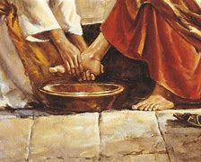
Context of the Lord’s Prayer
Chapter 13:1 The Passover Observance
Chapter 13:2-5 Jesus washes the disciples’ feet
Chapter 13:13-20 Instructions to serve others
Chapter 13:33-38 “I am leaving you” -- Peter would deny Jesus

Slide 4
Context of the Lord’s Prayer
Chapter 14:1-7 Let Not Your Heart Be Troubled”
Chapter 14:15-18 Jesus will pray for them
Chapter 14:26-29 The “Comforter”, peace & rejoicing at His leaving
Chapter 15:-8 True Vine & branches (fellowship)
Chapter 15:-9-15 True Love & friendship (fellowship)

Slide 5
Context of the Lord’s Prayer
Chapter 15:26-27 The Comforter reassurance
Chapter 16:1-13 Things are going to be hard but you will be comforted.
Chapter 16:17-30 “Little while” Confusion – The Disciples are obviously troubled over His departure.
Chapter 16:-31-33 The hour is here and you will leave Me. “Be of good cheer”
Chapter 17:1-26 Jesus prays for ALL of His disciples now & in the future.[verse 20]

Slide 6
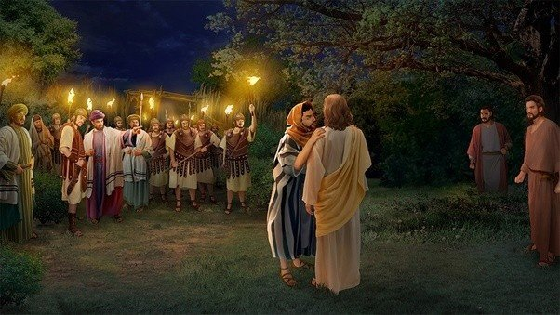
The Aftermath of the Lord’s Prayer in Gethsemane &
Matthew 26:33-44 Jesus prays 3 times to have burden taken away.
Imagine the anguish of the Father to say “no”
Matthew 26:47-59 Judas betrays Jesus and the disciples run away.
Everything was done to fulfil prophecy

Slide 7
The Aftermath of the Lord’s Prayer on the Cross
Matthew 27:44-46 “My God, My God why have you forsaken me?”
John 19:30 Jesus says, “It is Finished”
Luke 23:46 “Father, into your hands I commend my spirit”
Matthew 27:50-52 Temple veil torn, earth quaked, Graves opened & Bodies of the SAINTS arose.

Slide 8
Sermon on the mount model for the request, “Teach us to Pray”
the shorter version in the Gospel According to Luke (11:2–4)
The multitudes were hearing the message of a kingdom which was “at hand”.
Series of parables described this kingdom
The instructions for the multitudes was to pray in anticipation of this kingdom. Expect it soon!
Now that the kingdom is established and Jesus is reigning in heaven, praying for that which is already here is fruitless.

Slide 9
Come to Jesus!
If you are not a part of this kingdom, then that is what you should be praying for.
If you believe and convinced that you need to be added to this kingdom, then act now.
Romans 6:1-7 States plainly that baptism is the method of being born again.

