Slide 1
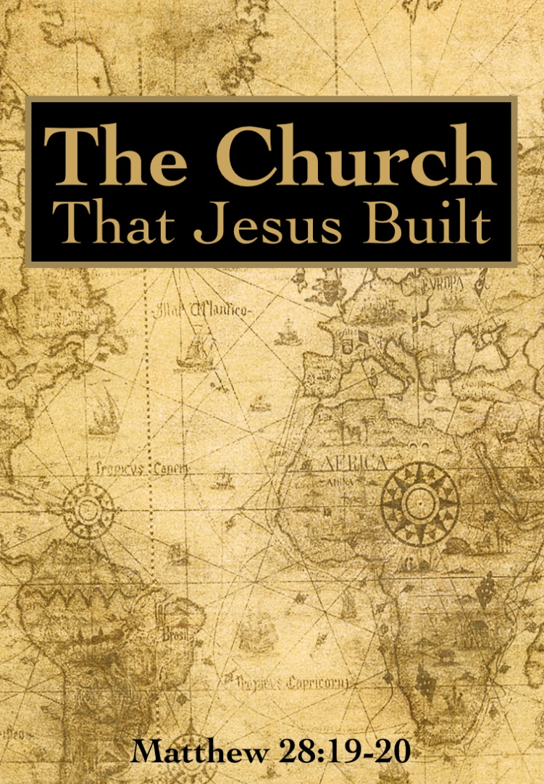
Restoring the Church That Jesus Built
Readings:
Luke 8:4-15
1 Timothy 3:14-15

Slide 2
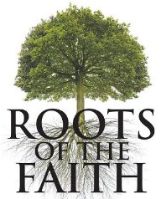
Roots
Since we can’t trace the church we attend back in time through Peter, How can we claim to be part of the true church?
How can a “Newcomer American Campbellite” church suddenly come into existence and be real?
How can we be sure that the newly-formed churches in Eastern Europe be part of a true church, when it’s roots are in America?

Slide 3
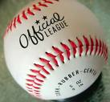
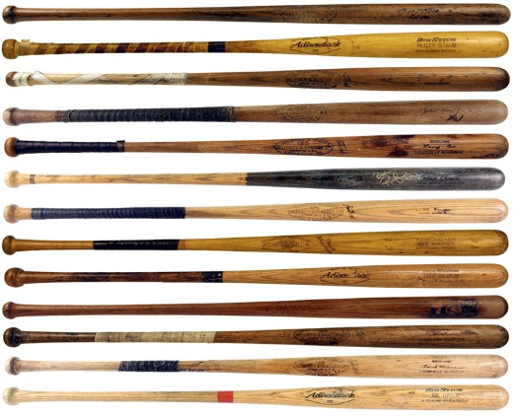
Baseball!

Slide 4
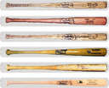
Baseball!

Slide 5
Baseball Revival

Slide 6
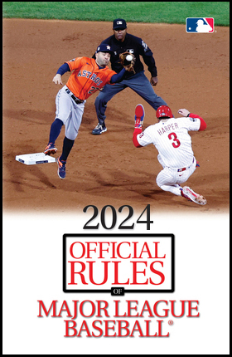
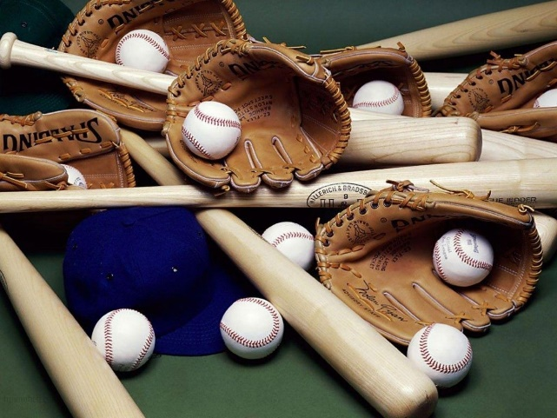
Baseball Revival

Slide 7
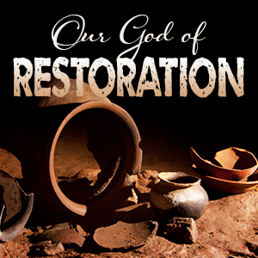
Baseball Revival
By FINDING the game according to the rule book and REVIVING it, he DID NOT INVENT baseball all over again.
He simply RESTORED a game that hadn’t been played for hundreds of years.
That is what men like Alexander Campbell did with the church.
Just as the rulebook gets dusted off and followed accurately you have baseball, the same goes for the church.

Slide 8
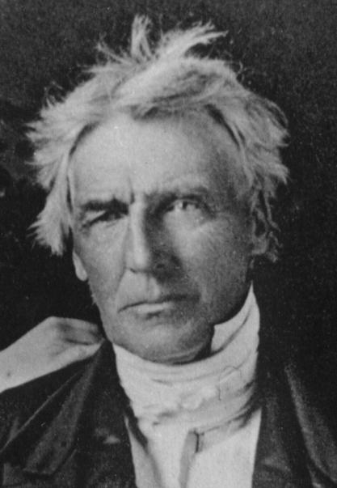
Baseball Revival
The Old Testament account of King Josiah [2 Kings 22] is an example of what men like Alexander Campbell and Barton Stone did with the church in the 1850’s.
Our mission is to Restore the church according to the Rule Book

Slide 9
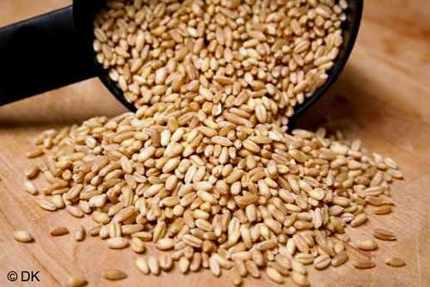
[Luke 8:4-15] Parable of the Sower
Seed can lie dormant for thousands of years.
Wheat that was found in the Egyptian pyramids grew and flourished thousands of years later when planted in the right environment.
The Lord’s church will grow and flourish when it is planted in the right environment.

Slide 10
The KEY To Restoration
Biblical TRUTH is the basis for unity.
Unity was Jesus’ prayer.
(John 17:20-21)
Paul gave the same plea.
(Ephesians 4:1-3)
(1 Corinthians 1:10)

Slide 11
We can’t have unity with denominational thinking.
(Ephesians 4:4-6) There is one body, and one Spirit, even as you are called in one hope of your calling; {5} One Lord, one faith, one baptism, {6} One God and Father of all, who is above all, and through all, and in you all.

Slide 12
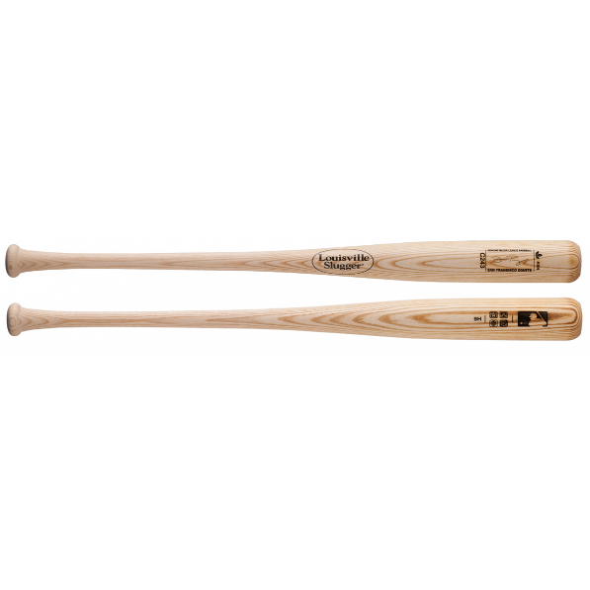
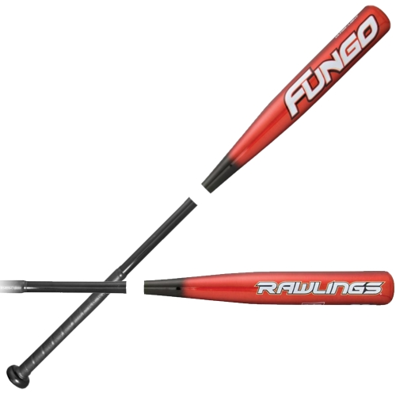
Baseball??

Slide 13
Baseball?
A likeness of baseball is not true baseball as defined by the rulebook.
I did not RESTORE baseball, I DISTORTED it.
When you take a religion that starts adding things to what the rule book says, and starts taking things out, you no longer have a RESTORED worship; you have a DISTORTED one.

Slide 14
Can we all understand the truth alike? (Ephesians 3:4)
Problem: We don’t want to follow the rules alike.
(John 8:32 )
The bible was inspired for our benefit
(1 Corinthians 2:4-13 )

Slide 15
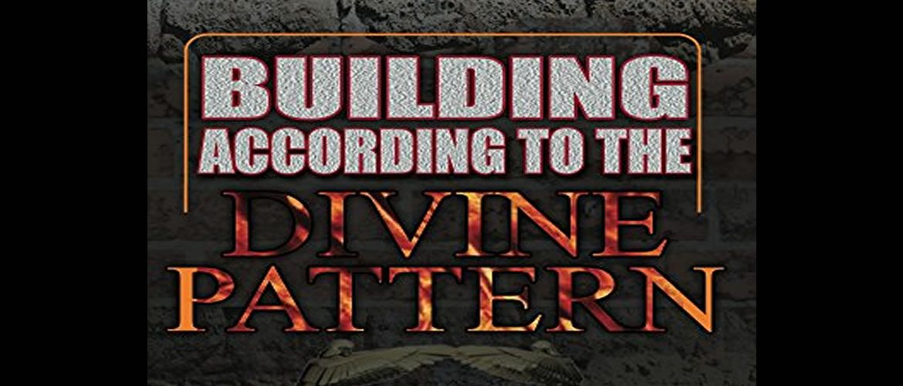
If we all went by the book…
What name should we have? (Acts 11:26) (Romans 16:16)
Bury souls in baptism [Romans 6]
Preach baptism for the remission of sins [Acts 2:38]
Imitate the work and organization of the original church.
Worship like the original church.

Slide 16
Is there only one true church?
Jesus died for one,
He bought only one,
Only saved people are in His body [church]. (Acts 2:47) Praising God, and having favor with all the people. And the Lord added to the church daily such as should be saved.

Slide 17
restoring our relationship with God Requires change
Change in intellect by faith. (Hebrews 11:6)
Change in our concept of Jesus the Christ. (John 20:30-31)
We need a change of will - that’s repentance. (2 Corinthians 7:10)
Confession is restoring your allegiance & making it known. (1 Timothy 6:12)
A man not willing to confess his faith doesn’t have it.

Slide 18
The FINAL Change In Restoration
A change of state happens.
(Galatians 3: 26-27) For you are all the children of God by faith in Christ Jesus. {27} For as many of you as have been baptized into Christ have put on Christ.
(Romans 6:3) Know you not, that so many of us as were baptized into Jesus Christ were baptized into his death?

Slide 19
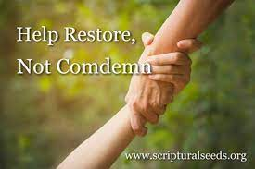
Our Part In Restoration
(Galatians 6:1) Brethren, if a man be overtaken in a fault, you which are spiritual, restore such a one in the spirit of meekness; considering thyself, lest thou also be tempted.

Slide 20
TRUTH – John 14:6
FIND the TRUTH
ACCEPT the TRUTH
OBEY the TRUTH
Be RESTORED to the TRUTH
JUDGED by the TRUTH

