Slide 1
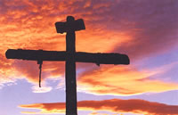
Resurrection Misconceptions
Reading – 1 Corinthians 15:1-11
Truth

Slide 2
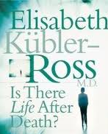
You may have heard a story of someone who “died” then came back
The most famous of all these, most probably is a woman by the name Elizabeth Kubler-Ross.
A book titled, “The Other Side” was received with much laud and honor from the religious world.

Slide 3
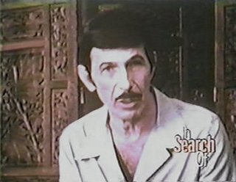
Usually there is a common thread to many of these types of stories.
After they “died”, they saw what was their description of either heaven or hell.
Usually these stories appear on TV amongst the same caliber of shows such as the search for the Loch Ness monster or the lost city of Atlantis.

Slide 4
Those who claim to have “come back” from the other side:
May truly believe it, but did not experience the visions that Paul or John had.
Scripture teaches that, And as it is appointed for men to die once, but after this the judgment. (Hebrews 9:27)

Slide 5
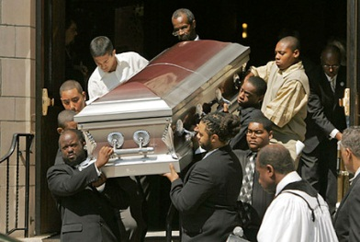
Concerning death:
A Song My Grandma Sang:
I wish you folks would come to church, If only for a visit.
For someday they will carry you in, And the Lord will say,
"Who is it?"
God does give us glimpses of heaven and hell – THE BIBLE!

Slide 6
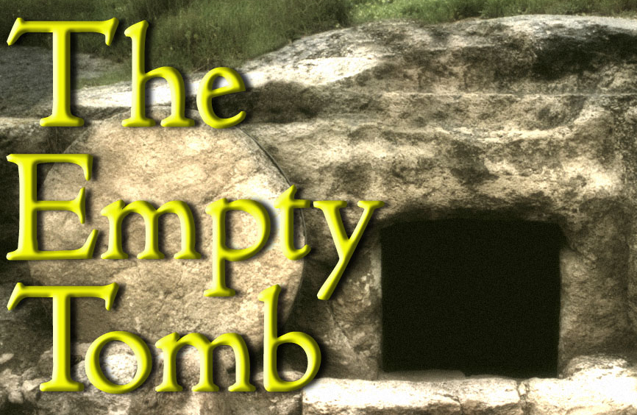
The Resurrection is a Fantastic Claim to the Unbeliever
Either because of lack of understanding or willful denial of the power of the Resurrection Story, some people have distorted and misguided and outright un-Biblical views.
Just because someone says to you, "I believe in the resurrection," does not necessarily mean what you may think, as we will see.

Slide 7
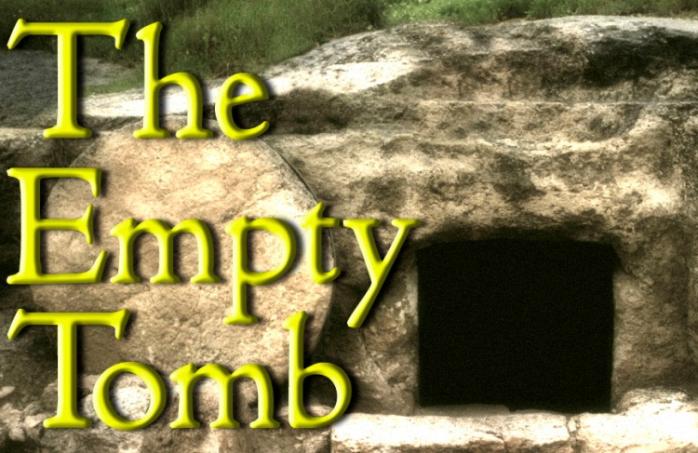
Application of the Text
1 Corinthians 15:1-3
The Resurrection

Slide 8
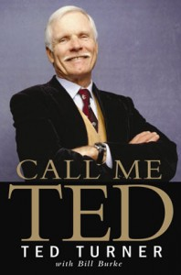
[Verse 3] Christ died for our sins
Ted Turner quote: “I don't want anybody to die for me. I've had a few drinks and a few girl friends. If that's going to put me in hell, then so be it.”
In spite of this attitude
(2 Corinthians 5:15)

Slide 9
{4} and that He was buried, and that He rose again the third day according to the Scriptures,
One Popular explanation: Jesus “swooned” on the cross:
What if your preacher said that Jesus just swooned on the cross and that the disciples nursed Him back to health. What would be your reply?
“Let me beat you with a cat-of-nine-tails with 39 heavy strokes, nail you to a cross and let you hang there in the sun for 6 hours --- Then run a spear through your side.
After that we will put you into in an airless tomb for 36 hours and see what happens.

Slide 10
Read vs. 5-9
One of the meekest men in history was John the Baptist.
When asked who he was, he simply said, "I am nobody. I am to be heard, not to be seen. I am just a voice."
Did you ever notice that David never describes his victory of Goliath in all of the psalms?
" Where is our pride? Where is our meekness?
(Romans 12:3)

Slide 11
vs. 10
{10} But by the grace of God I am what I am, and His grace toward me was not in vain; but I labored more abundantly than they all, yet not I, but the grace of God which was with me.
Let’s try to discover what the resurrection is.

Slide 12
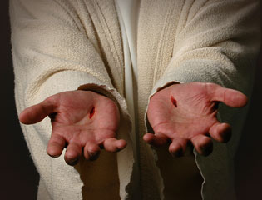
The Resurrection does not refer to a remaining phantom
Luke 24:39
*

Slide 13
Hear this clearly:
The grand affirmation of the New Testament is not "He lives," but "He is risen."
The resurrection becomes an experience for us as well because we are resurrected WITH Jesus.
Romans 6:5

Slide 14
The Resurrection should see a revived faith
*
*

Slide 15
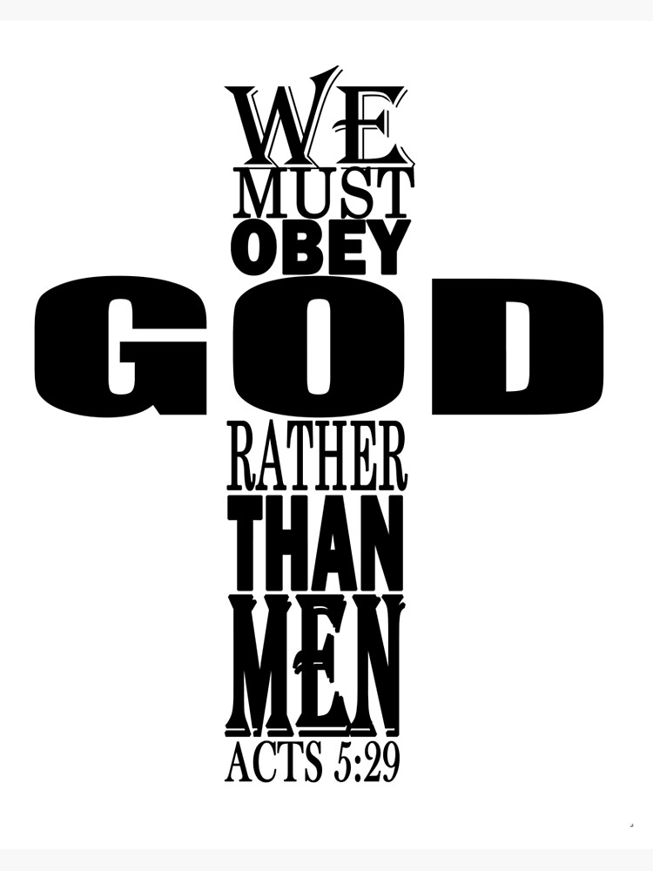
When Jesus died on the cross AND arose, His followers gained a revived faith.
Their revived faith caused them to grow a backbone.
[Acts 5:29]
It was not Jesus alone who had been risen, but the disciples' faith in Jesus that had been risen WITH Him.

Slide 16
When Jesus died on the cross AND arose, His followers gained a revived faith.
The way the disciples were able to have their faith renewed was by witnessing the risen Lord!
It gave them a cause worth dying for.
It gave them a cause to rejoice in spite of persecution.
It gave them hope in Jesus’ promises.
[Matthew 6:33]
[John 14:1-3]

Slide 17
The Resurrection sees the same –but- renewed person.
*
*

Slide 18
Before and after the resurrection, Jesus is the same person.
But the resurrection gave him a renewed and glorified body.
God arrested the natural processes of decomposition. Acts 2:27
Being a renewed person in the resurrected LORD, man's deepest fear is removed.
We no longer fear death.

Slide 19
Before Jesus, millions had experienced death, but no one had ever come back.
Jesus vanquished man's greatest fear. The sting of death was gone.
Jesus has assured us if we know him then we too will be resurrected.
(John 11:25-26)

Slide 20
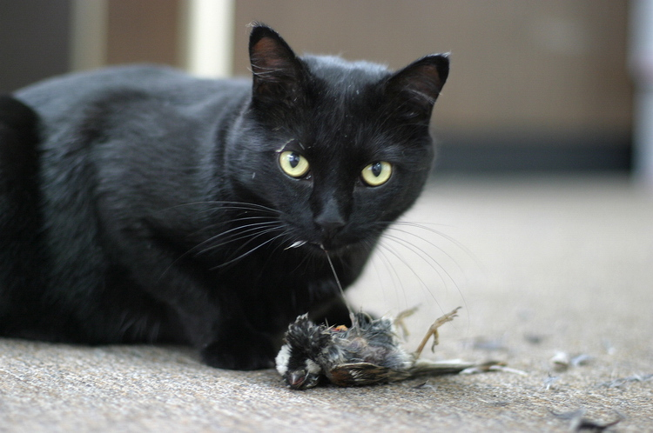
Why does this bother someone?
Some are horrified by seeing or hearing about this!

Slide 21
Yet this is not disturbing?
When is it time for your Resurrection?

