Slide 1
SPIRIT of Worship
Reading - John 4:4-24

Slide 2
Most people know the story of Jesus and the woman at the well.
Samaritans were a religious people, but their worship became a Mongrel version of true worship.
No doubt many were doing as best as they can.
They were looking for and longing for the Christ to appear to deliver them.

Slide 3
They were worshiping at a huge disadvantage.
Purebred Jews would not share true worship with them.
They would be denied access to the temple and the priests would not accept their sacrifices.
These despised “dogs” were more than willing to accept Jesus as the Messiah. They were thirsting for His living water.
Acts 8 tells of the phenomenal success of the spread of the Gospel in Samaria.

Slide 4
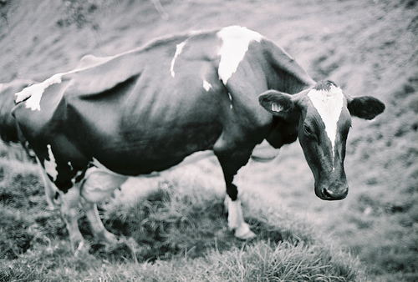
A Good Example of a BAD Example
[Malachi 1:6-14]

Slide 5
Many of the Jews of Jesus’ day were not hand- to-mouth slaves of the Roman Empire.
Jerusalem was a booming trade center of its day.
The Persians PAID to rebuild it for that very purpose.
“Jewel of Commerce” by Alexander the Great
Herod family were vassal kings that faithfully send tribute money back to Rome.
The government WANTS the Jewish merchants and craftsmen to prosper because increased wealth = increases tax revenues.

Slide 6
The more wealth the people had the harder it was for them to truly sacrifice.
The priest were turning a blind eye to the junk that the people were offering to God. [verses 6-8]
Then they had the audacity to petition God for even more material blessings! [verse 9]
{Verse 10} God’s wish is to have someone with a backbone to shut them down. Jesus was the one who did just that in cleansing the temple TWICE.
{verse 13} The Jews had not stopped worshiping, but going through the motions became a “weariness” to them because their heart was not in it.

Slide 7
¹⁴Cursed be the cheat who has a male in his flock, and vows it, and yet sacrifices to the Lord what is blemished.
God looks at vows as sacred.
Matthew 19 tells us of God’s attitude on those who cheat on their marriage vows.
[Judges 11:30-36] -- Jephthah

Slide 8
How Do We Compare To The Jews?
Surely there is no comparison!

Slide 9
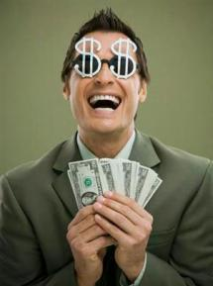
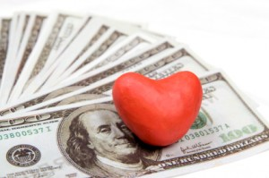
Money is a god of this world that has many worshipers.
If we are not diligent we can allow it to steal our heart from the one, true & living God.
[2 Timothy 2:15]

Slide 10
How did you present yourself to God this morning?
[2 Peter 1:5-11] For this very reason, make every effort to supplement your faith… more diligent to make your calling and election sure…
What better way to supplement your knowledge by attending services at 9 AM?

Slide 11
Are we giving as we are being prospered or are we finding ways to substitute LAME sacrifices to God?
[1 Corinthians 16:2]
[2 Corinthians 9:6-8]
What have you purposed and are you abiding by the terms of your vow?
Abraham made a vow before it became LAW.
Estate Inheritance Scenario

Slide 12
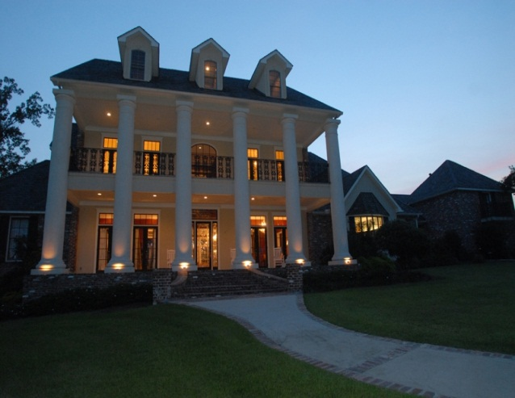
How Do We keep our vow?
$500,000 estate sale

Slide 13
$50,000 for the Lord!
$500,000 Minus
$175,000 Estate Taxes
$10,000 Probate Lawyer
$35,000 Broker & Accountant Fee
$50,000 New Car
$150,000 Pay Off Mortgage & Debts
$80,000 Remaining

Slide 14
OK -$8,000 for the Lord!
BUT -----
If I write a check for over $250 I can’t take it off my taxes!
I’ll put my regular check in the collection plate and increase it by $153.85 for ONE year!

Slide 15
Malachi 3:8-10
⁸Will man rob God? Yet you are robbing me. But you say, ‘How have we robbed you?’ In your tithes and contributions. ⁹You are cursed with a curse, for you are robbing me, the whole nation of you. ¹⁰Bring the full tithes into the storehouse, that there may be food in my house. And thereby put me to the test, says the Lord of hosts, if I will not open the windows of heaven for you and pour down for you a blessing until there is no more need.

Slide 16
Is serving God a “weariness”?
Texting during services. BOREDOM
Restroom & water cooler visits
Extra opportunities to serve. [Forced Fellowship]
Song & Scripture Service. “But I don’t LIKE to sing!”
[Psalms 122:1] I was glad when they said to me, “Let us go to the house of the LORD.”

Slide 17
The spirit of Holiness
Psalm 29:2
1 Peter 1:13-16

Slide 18
“Holy” “Saint” & “Sanctified”
All have similar connotations.
Our lives are to be set apart from sin.
[Psalms 24:3-4]
How do we know this is a holy place?
[Matthew 18:20]

Slide 19
Serving God is a holy thing.
Do we have a Spirit of Gratitude for Jesus?
Do we realize the privilege we have to assemble to worship?
Do we set the Lord’s day aside as a holy thing?
Does He get the FIRST & BEST of our service?

