Slide 1
The Un-Chosen People (The Gentiles)
Reading Ephesians 2:11-18

Slide 2
Israel was the Chosen people because of the covenant that God made with Abraham
What about the millions of people who were not chosen?
Does this give credence to the Calvinistic doctrine of Predestination?

Slide 3
God’s word deals with God’s promise to “all nations”.
Little attention is paid to non-Israelite nations except in reference to contact with the Israelites.
The theme of the Bible deals with the reconciliation of God to His people

Slide 4
Israel and its remnants were chosen for a specific purpose.
(Deuteronomy 7:6-8)
God’s people today are described as a “spiritual Israel.”
1 Peter 2:9-10

Slide 5
What of the Gentiles during the dispensation of the Law of Moses?
Were they completely excluded from service to God?
Was there no way for them to be pleasing to God if they so desired?
Please consider the following:

Slide 6
O.T. Examples of faithful Gentiles
Job (Job 1:1 & 22)
Rahab (Joshua 2:9-11) (Hebrews 11:31)
(James 2:25)
Ruth (Ruth 1:8-18)
Ninevites (Jonah 3:10)

Slide 7
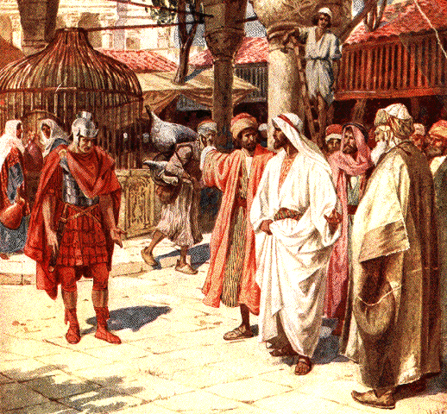
N.T. Examples of Faithful Gentiles
The Centurion of Matthew 8: 5-13
Again a great man of faith held up by the Lord Himself.
Notice how Jesus mentions 2 kingdoms here.
a. of heaven
b. of Israel
Cornelius (Acts 10:1-6; 31)

Slide 8
God Is No Respecter of Persons
(Acts 10:34-35) (1 Peter 1:17)
Was this message limited only to the Jews?
(Romans 2:7-12)
Not just a New Testament passage:
(2 Chronicles 19:7)
Has God ever changed His nature or His position?

Slide 9
God gives ALL men a choice.
Either serve God or to separate from Him by sinning.
In the Garden of Eden man had a choice.
Under the NT we have a choice whether to follow Jesus or not.
Can we say with all confidence that the Gentiles had no choice and automatically condemned to hell because of their nationality?

Slide 10
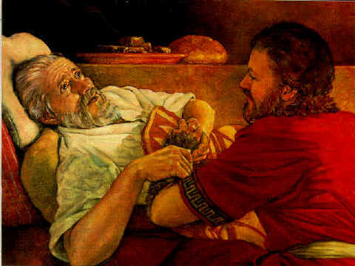
The matter of Jacob and Esau
Romans 9 states that God chose Jacob for a certain purpose.
Did God approve of the deception and sins that allowed Jacob to get the birthright and blessing?
The only answer one can give is NO!
God never approves of sin end.

Slide 11
Abraham Is “Father” of All The Faithful
Romans 4:1-14 - he was a Gentile.
The book of Romans has a basic two-fold goal.
First, it brings all men under the condemnation of sin (3:10, 23).
Secondly, it gives all men the assurance that they can be saved from such sin by obedience to the gospel of Christ
1:10 describes it as “the power of God unto salvation to everyone that believes; to the Jew first and also to the Greek.”

Slide 12
This is an important point:
Israel was God’s chosen people for His plan. They were NOT chosen for salvation. -Romans 9:1-5
The Gentiles were NOT bound to the Old Law.

Slide 13
What Was The State of the Gentiles During the Old Law?
More than likely the majority lived their lives in rebellion to God and were lost. [Matthew 7:13-14]
Can we say they had no means of worshipping and serving God?
Consider the patriarchs. (How did Abraham or Job or Cornelius know how to please God?)

Slide 14
Some other “Gentiles” who served God
Adam, Abel, Enoch, Methuselah & Noah
Could the Gentiles serve God? YES
For the most part did the Gentiles serve God? NO
For the most part ISRAEL didn’t serve God!

Slide 15
Consider the Ephesians
Ephesians 2:11-13
The state of sinful men (outside of Christ) both Jew and Gentile is just as bleak.
It does not say that ALL Gentiles were condemned without reason
It doesn’t say they were condemned because of their nationality
Consider Romans 1:18-32

Slide 16
Let’s Finish Ephesians 2
[Vs. 14-18] For He Himself is our peace, who has made both one, and has broken down the middle wall of separation, {15} having abolished in His flesh the enmity, that is, the law of commandments contained in ordinances, so as to create in Himself one new man from the two, thus making peace, {16} and that He might reconcile them both to God in one body through the cross, thereby putting to death the enmity. {17} And He came and preached peace to you who were afar off and to those who were near. {18} For through Him we both have access by one Spirit to the Father.

Slide 17
The Old Law had separated people from one another NOT from God.
Only sin separates from God.
God never casts off any person unless they first cast him off

Slide 18
Notice that this last text says that Jesus is our PEACE.
If you are without Jesus you do not have peace.
You may have a temporary reprieve from strife but not true peace.
If you claim to be a Christian and you say you don’t have peace, then who’s fault is that?

