Slide 1
A Challenge TO Obey
Reading – Psalm 62:1-7

Slide 2
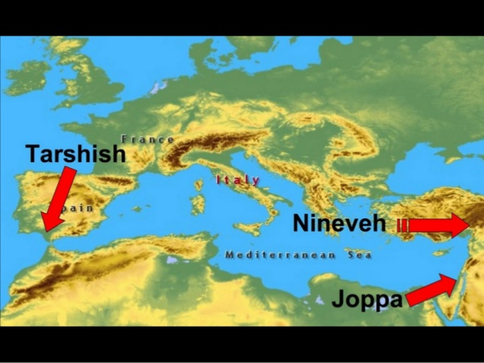
Jonah was NOT one of the Faithful/Believing prophets
He was not called to preach to Israel
The book is NOT about his message
Jonah was called to leave Israel and go to the Assyrian city of Nineveh
No other prophet was called to preach directly to a foreign nation.

Slide 3
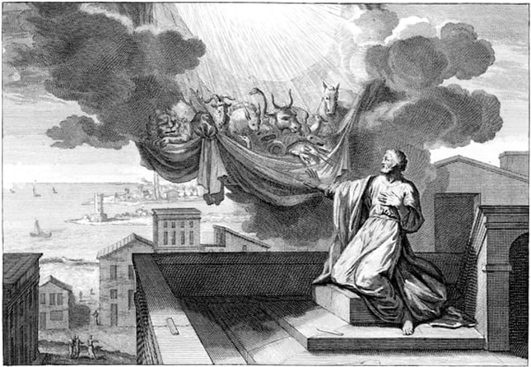
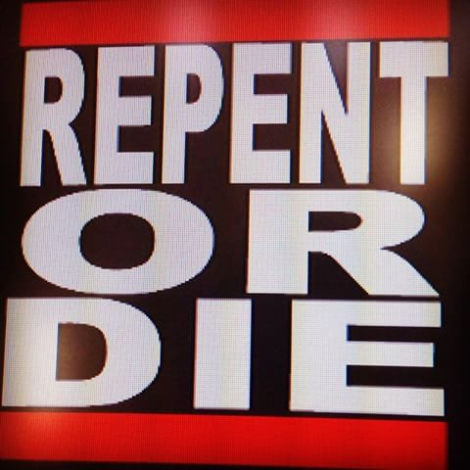
What Was The Message?
Most people would say that it was about Repentance
He is not a missionary
He is a harbinger of doom
This story is about Jonah, not his message.
Acts 10 is not about the conversion of the Centurion, but the conversion of Peter and his Jewish companions.

Slide 4
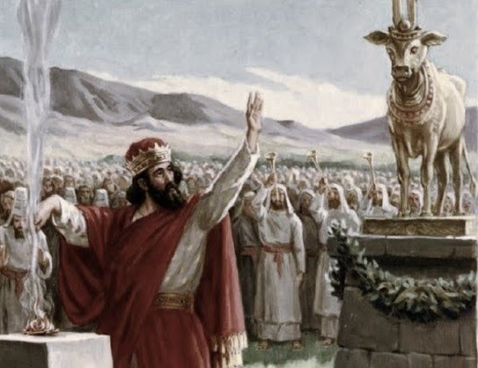
Background
Jonah prophesied in the reign of Jeroboam II [2 Kings 14:25-27]
He prophesied POSITIVE things about Jeroboam's reign, despite the evil the King committed.
His contemporary prophets were Hosea and Amos.
They preached NEGATIVE things about the condition of the Israelites

Slide 5
Nineveh
An important city to Assyria.
The city was approx. 3 miles in circumference.
The Assyrians were a fierce conquering foe.
The enemy of Israelites.

Slide 6
Jonah 1:1-3: Jonah Runs for His Responsibility
This is proof of God’s Love, Mercy & Longsuffering for ALL people.
Jonah’s reaction was like that of Adam & Eve

Slide 7
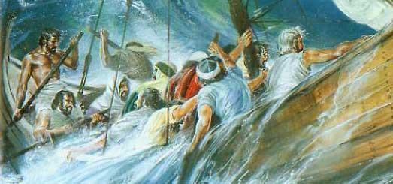
Jonah 1:4-16 Jonah & the Sailors
Jonah unintentionally preaches the power of God.
Through Jonah's disobedience, God draws unbelievers to Him.

Slide 8
Jonah 1:17thru 2:10 Jonah & the Fish of Deliverance
The fish was not a punishment; it was a vehicle of salvation.
It was God’s gift in response to his prayer when sinking to the bottom of the sea.
.

Slide 9
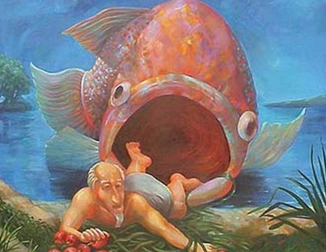
The Fish of Deliverance
While in the fish Jonah prays.
Considering the context of this story the prayer seems quite selfish.
By now he should have been painfully experiencing what it would be like to be digested alive.
Salvation is from the Lord [vs.9], but the method is not always pretty

Slide 10
Jonah 3:1-5 Jonah in Nineveh
This map may explain why it took Jonah 3 days to preach.
The Message: “In 40 days, the city would be overthrown.”
Overthrown [Genesis 19:24-25] same fate of Sodom & Gomorrah
Jonah did NOT tell the people to repent.
Nevertheless, the people DID repent & God Relented.

Slide 11
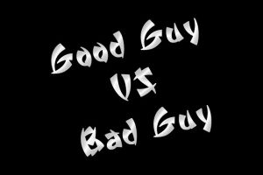
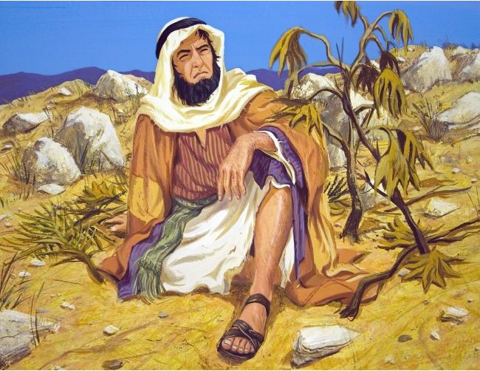
Jonah 4:1-11 Who’s the Good Guy?
Hard to tell.
Jonah is disobedient, angry, hateful and selfish.
Even when he obeyed, he did so grudgingly.
The unbelieving Gentiles are presented as being more faithful.

Slide 12
Consumed by Unforgiveness
We are left to answer the question ourselves.
Is our concern God’s concern?
Do we care about what God cares about?
Our obedience should flow from a heart committed to the work of the Lord.

Slide 13
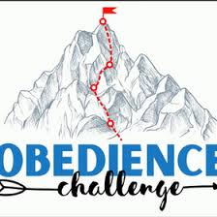
A Challenge TO Obey Matthew 28:19-20
God is calling you today to accept the challenges of obedience

