Slide 1
To Generation Alpha
Reading - Luke 1:39-50

Slide 2
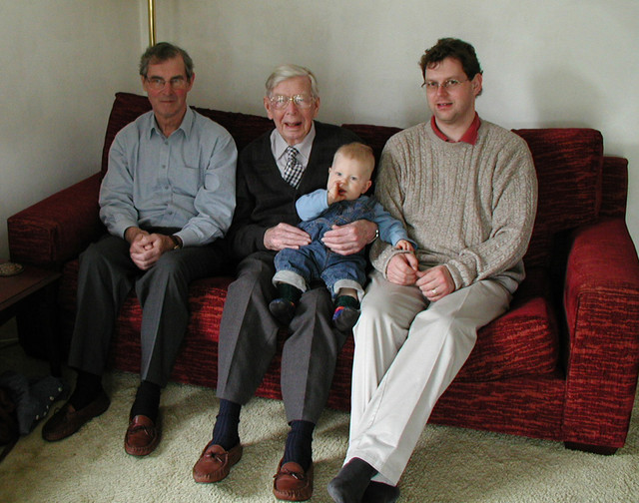
There has been many generations of men since the beginning of time.
How many of them would be characterized as "those who fear Him?"

Slide 3
Generations Chart

Slide 4
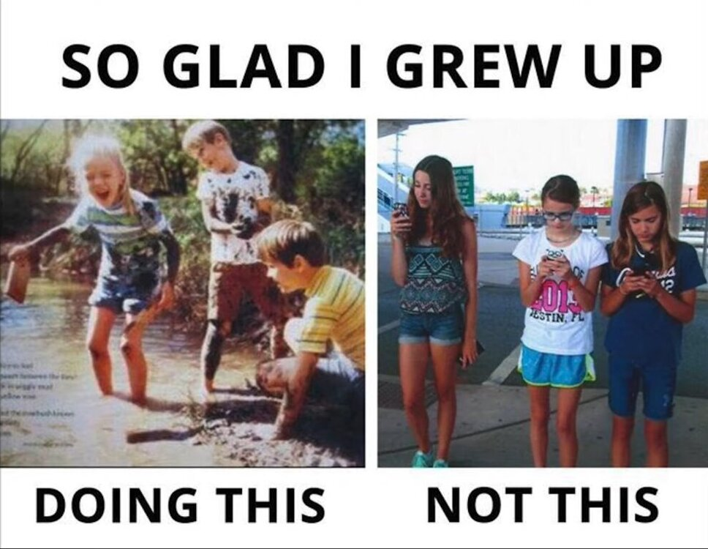
“The Age of Tolerance”
Will this be characteristic of Gen Alpha?
No real standards of performance.
“No one is wrong – just different”
Children are raised by “who-knows-who?”
Domestic permanence is a foreign concept.
Lack of patience, attention span, technology dependent.
Many generations have been characterized in almost the same way by preceding generations.

Slide 5
Of Times Past
A Short Bible Synopsis

Slide 6
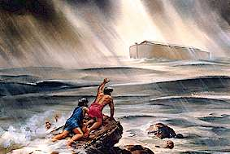
Biblical Generations
Generation of Enosh - (Genesis 4:26)
Mankind started out on the right footing.
It didn’t take too long for mankind to slip.
Generation of Noah - (Genesis 6:5)

Slide 7
Biblical Generations
Then we come to the Generation of Israel (Wilderness Years)
(Numbers 32:13)
(Deuteronomy 1:35)
(Deuteronomy 32:5; 20-22)
(Psalms 95:10)

Slide 8
Biblical Generations
Then we have the Generation of Joshua
(Joshua 24:31)
Here we have a generation that served God and who were in turn rewarded with the Promised Land.
Then we come to the Generation of the Judges
(Judges 2:10-11)
It doesn’t take a nation long to forget God.
It may not happen in one generation, but it becomes more progressive with each new generation.

Slide 9
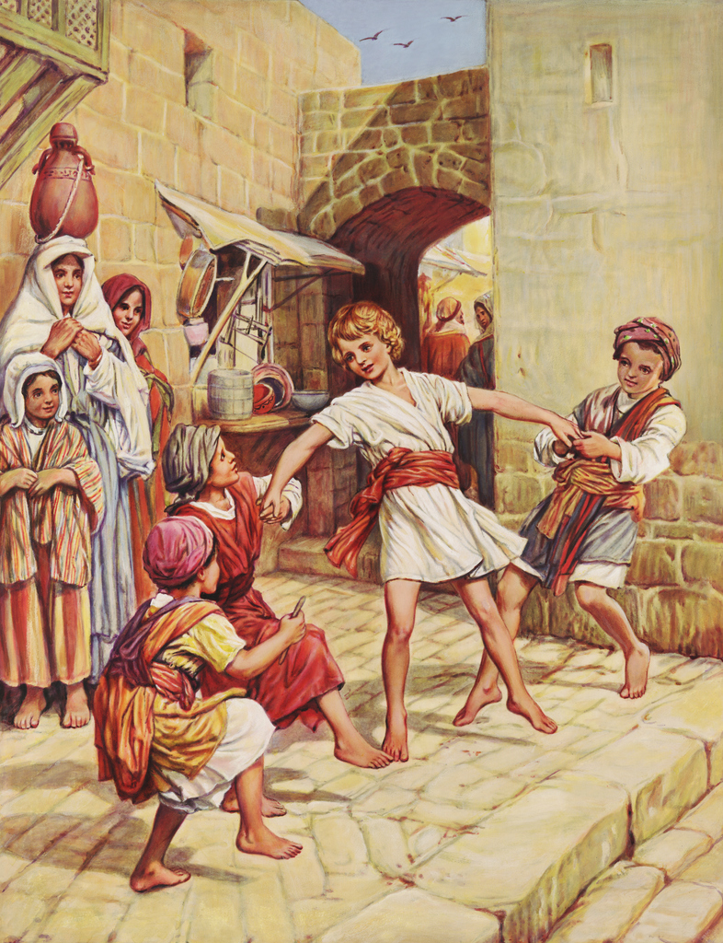
Look at the Generation of 1st Century
The religious leaders were proven to be hypocrites.
Jesus described that generation well:
(Matthew 11:16-19)
(Matthew 12:39-45)
(Mark 8:38)

Slide 10
What About Our Present Generation?
Do we change the Message of God to Accommodate Today’s “Special” Needs?

Slide 11
What does Generation Z want from religion?
According to Christianity Today article they want Authenticity – No frills -- unity & love –
The gospel does not have to be changed to provide this.
A sense of Community –
They are homesick for homes they never had.
No Dogmatism: 81% don't believe there is absolute truth
Even when confronted with compelling scriptural evidence they are likely to say, "So what?"
Growing up in a pluralistic, multi-cultural society they have a hard time accepting one belief over another.
They have focused on the Arts & Technology as a constant

Slide 12
The reality of the matter
God’s Message has remained the Same For Each Generation!
Ecclesiastes 1:4
Ecclesiastes 12:13-14
(Psalms 78:6-8)
(Luke 1:50)

Slide 13
Just Who Is The Chosen Generation?
1 Peter 2:9

Slide 14
Every Christian from Every generation must be an example of a believer to the masses of unbelievers
Philippians 2:15
Paul’s generation did not have the corner on perversion?
His generation did not have a corner on hypocrisy either.
In Acts 2:40 the people were instructed to obey the Gospel in order to... "Be saved from this perverse generation"

Slide 15
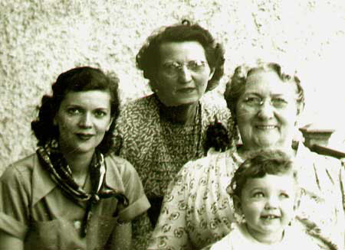
God has mercy on those who fear Him in any generation, and condemns those who reject Him.
"Be saved from this perverse generation"

