Slide 1
Why Don't You........?
Reading: 1 Peter 3:12-21

Slide 2
(1 Peter 3:15) But sanctify the Lord God in your hearts: and be ready always to give an answer to every man that asks you a reason of the hope that is in you with meekness and fear: 1 Peter 2:9
When we answer anyone, we must be able to cite our authority.
Colossians 3:17
1 Peter 4:11
Galatians 1:8

Slide 3
You Need Authority To Make The Pieces Fit
God has a right to determine how HE is to be worshipped.
[Ex] Cain and Abel’s Sacrifice Genesis 4:1-8

Slide 4
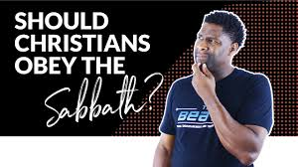
Why Don't You........ Keep The Sabbath?
Given to Israel only - Deuteronomy 5:1-3
The end of the Sabbath was prophesied - Amos 8:5&9
Christ’s death ended the Sabbath. Colossians 2:14
Colossians 2:16 ... Let no man therefore judge you in meat, or in drink, or in respect of an holy day, or of the new moon, or of the Sabbath days:

Slide 5
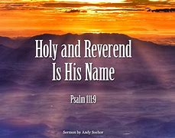
Why Don't You........ Wear Religious Titles?
Christians Acts 11:26
1 Peter 4:16
What’s wrong with calling a man Father or Rabbi? Matthew 23:8-9
How about Reverend? (Psalm 111:9) He sent redemption unto his people: he has commanded his covenant forever: holy and reverend is his name.

Slide 6
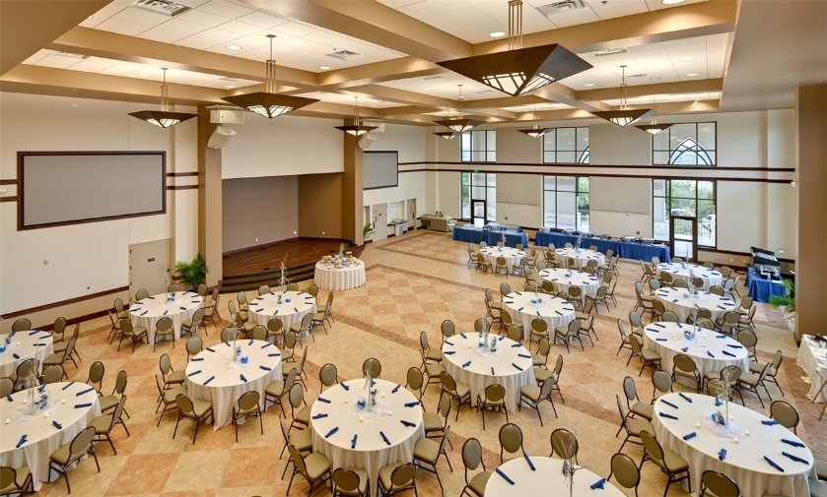
Why Don't You........ Have Fellowship Halls & Church Functions?
What exactly is the church’s function?
To Teach Matthew 28:19
2 Timothy 2:2
To Worship John 4:24
“Fellowship in the church” is not coffee & donuts but mutual participation in spreading the Gospel.

Slide 7
Why Don't You........ Have Fellowship Halls & Church Functions?
Jesus died to save men’s souls - NOT to have a ball team named after him. John 18:36
The physical needs of man are to be satisfied at home. 1 Corinthians 11:22-34
Instead of a spiritual feast, man is opting for a physical feast. Luke 4:4
The spiritual needs of man are fed by the Fellowship of Christ through His word.

Slide 8
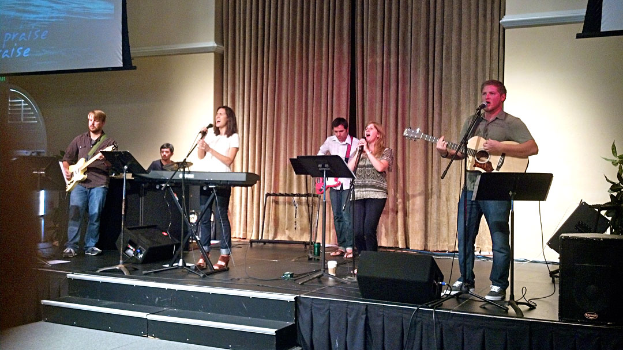
Why Don't You........ Use musical instruments in your worship services?
Ephesians 5:19
Colossians 3:16
1 Corinthians 14:15
Matthew 26:30
Acts 16:25

Slide 9
The instrument is just an AID
Can we add things to God’s word and be completely certain that it is pleasing to Him?
Can you be sure that all instrumental music was pleasing to God in the Old Testament?
Amos 6:1-5

Slide 10
“I know what the Bible says but...
“I Don’t think........”
“I Don’t believe.....”
And That’s The Trouble.........

Slide 11
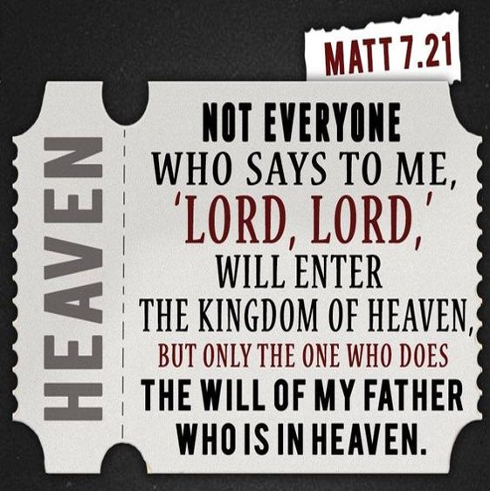
TOO MANY PEOPLE DON’T THINK AND DON’T BELIEVE!

