Slide 1
Welcome to the
Covington church of Christ

Slide 2
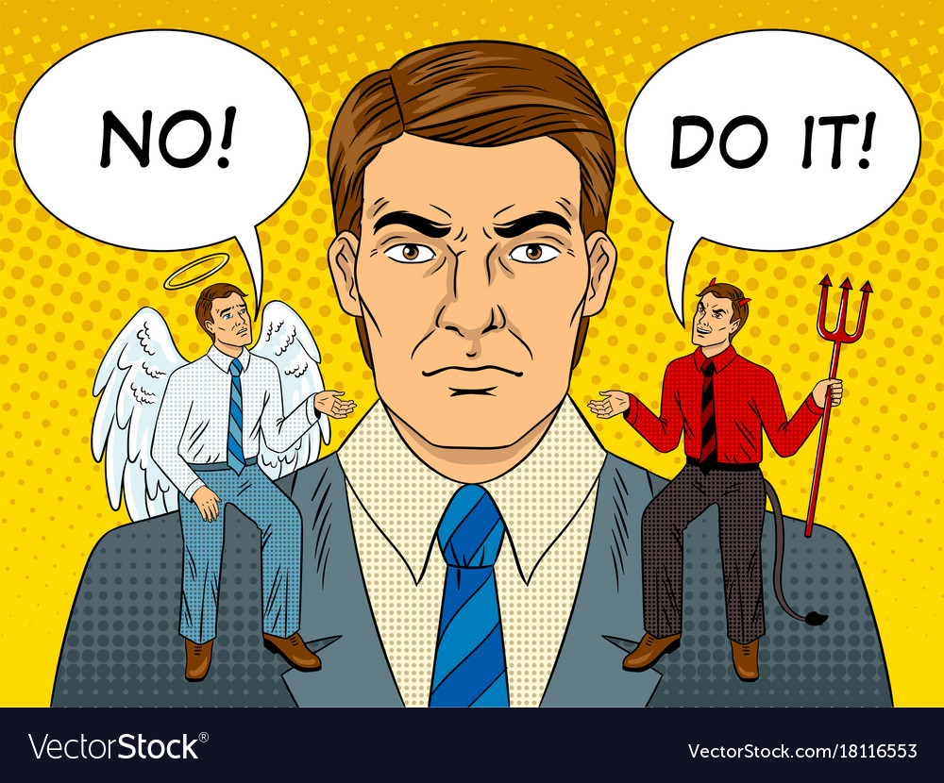
Don’t be led by the Flesh

Slide 3
Adam and Eve
Even in the perfect environment, the flesh can still be tempted.
Doesn’t matter who you are with.

Slide 4
King David
Doesn’t matter what your social status is.
It begins to add up quickly.

Slide 5
Jesus
When the flesh starts to take over, stop and pray.
Had to fight the flesh and it wasn’t easy.

Slide 6
Conclusion
Doesn’t matter where or who you are with.
Sin can add up quickly.
Stop and Pray.

Slide 7
GOD’S PLAN OF SALVATION
Hear (Rom. 1:16; 10:14, 17)
Believe (John 8:24; Mark 16:16; Heb. 11:6)
Repent (Acts 2:38; 3:19; 17:30)
Confess (Rom. 10:9-10; Matt. 10:32-33)
Be baptized (Acts 2:38; 22:16; Mark 16:16)
Live faithfully (Rev. 2:10; Matt. 6:33; Rom. 12:1-2; I Cor. 15:58)

Slide 9
Welcome to the
Covington church of Christ

